Slide 1
Customer Churn Prediction Using the IBM Telco Dataset
Ksenia Romanova and Shamma Alhosani

Slide 2
Why Churn Matters
Customer churn, or when customers cancel a service, is a big issue for subscription-based companies. Since keeping existing customers is much cheaper than finding new ones, companies really benefit from knowing who is most likely to leave.

Slide 3
Goal
The main goal of this project was to build a model that predicts the probability that a customer will churn.
Instead of just asking “will this customer churn or not,” the focus was on estimating risk, since churn models are usually used to decide who to reach out to, not to make perfect predictions.

Slide 4
The Dataset
IBM Telco Customer Churn dataset
7,043 customers
Target variable: Churn (1 = churned, 0 = stayed)
Features include customer demographics, services, billing, and contract details
About 26.5% of customers in the dataset churned
Each row represents one customer.

Slide 5
Cleaning & Setup
Before modeling, the data needed some cleaning:
Churn was converted from Yes/No to 1/0
TotalCharges was converted to numeric, with a small number of missing values filled in as 0 for new customers
customerID was dropped since it’s just an identifier
A few extra features were created, like tenure buckets and a high monthly charges indicator
After this, the dataset had 22 usable features.

Slide 6
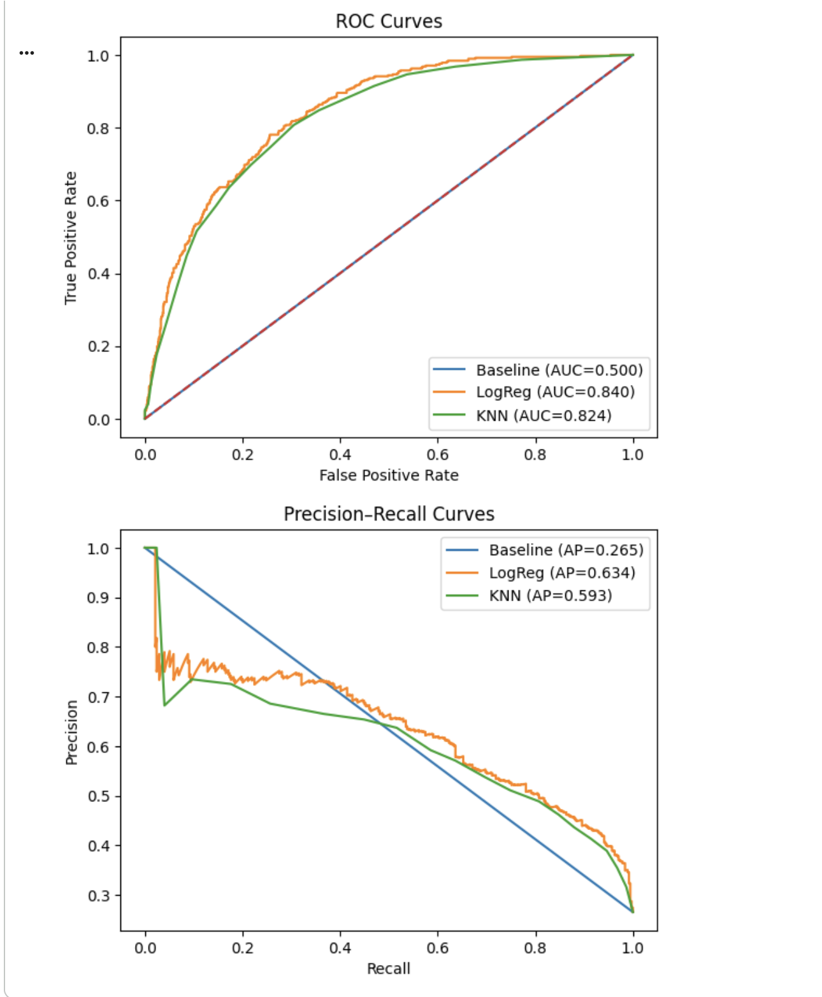
What Data Showed
Some churn patterns stood out pretty clearly:
Month-to-month customers churn way more than long-term contract customers
Fiber optic users churn more than DSL or no-internet customers
Customers paying with electronic checks churn the most
Customers without support or security add-ons are more likely to leave
These trends showed up both in the EDA and later in the model results.

Slide 7
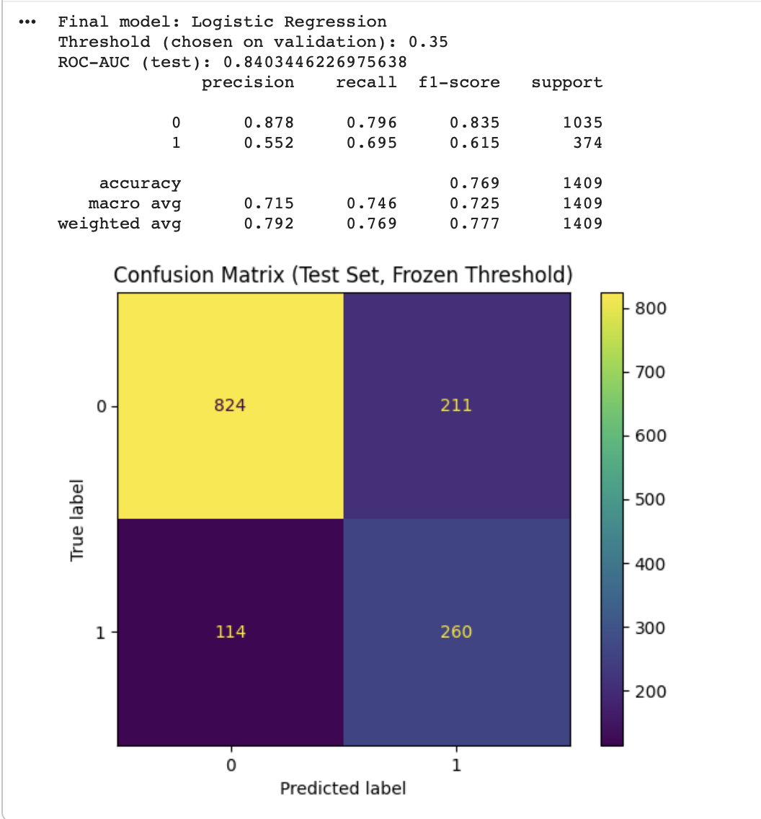
How We Modeled It
The data was split into training and test sets using an 80/20 split.
We used a preprocessing pipeline to handle missing values, scale numeric features, and encode categorical variables.
The models we tested were:
A Dummy Classifier as a baseline
Logistic Regression
K-Nearest Neighbors
We mainly compared models using ROC-AUC instead of accuracy.

Slide 8
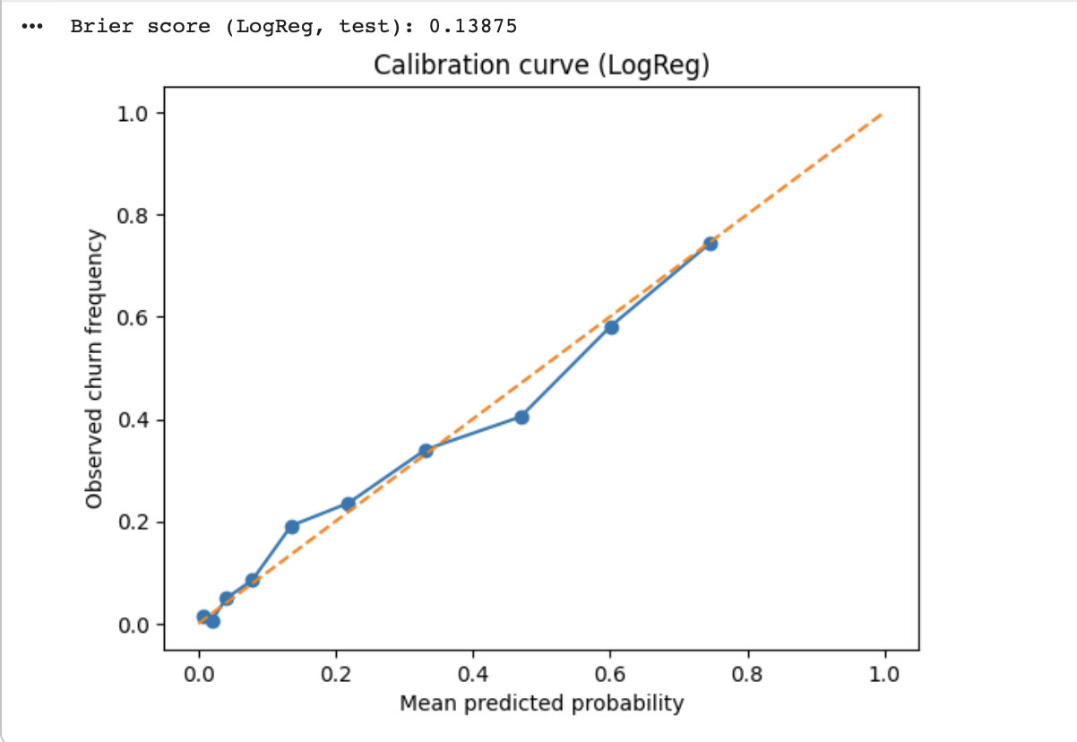
Best Model and Threshold
Logistic Regression ended up working best, with a test ROC-AUC of about 0.84.
We also didn’t stick with the default 0.50 threshold. Instead, we tested several thresholds and chose 0.35, since it gave the best balance between catching churners and not flagging too many customers.

Slide 9
What The Results Mean
At the 0.35 threshold:
The model catches about 72% of customers who actually churn
Around 34% of customers are flagged as high risk
From a business standpoint, this makes sense if the company can handle outreach to about one-third of its customers and wants to catch most churners early.

Slide 10
Conclusion
Overall, this project shows how churn prediction can be approached in a practical way, not just by maximizing accuracy.
Logistic Regression gave strong performance and was easy to interpret, and using probabilities and threshold tuning made the results much more realistic for real-world use.
If we were to continue this project, we’d look at cost-based thresholds, probability calibration, and customer segmentation.

Slide 11
Data source &
key fields
Data source
IBM Cognos Analytics sample dataset: “Telco customer churn” (fictional telco churn data).
• Public mirror commonly used in coursework: Kaggle dataset “Telco Customer Churn” (blastchar), file WA_
• Accessed: Dec 15, 2025
Key fields used in modeling
• Target: Churn (Yes/No).
• Numeric: tenure, MonthlyCharges, TotalCharges (may need numeric conversion).
• Contract/billing: Contract, PaperlessBilling, PaymentMethod. • Service features: InternetService + add-ons (OnlineSecurity, TechSupport, etc.).
• Customer attributes: SeniorCitizen, Partner, Dependents, gender.

